Slide 1
MY SUMMER HOLIDAY
张安成
Class1,Grade4 . No. 33
张安成

Slide 2
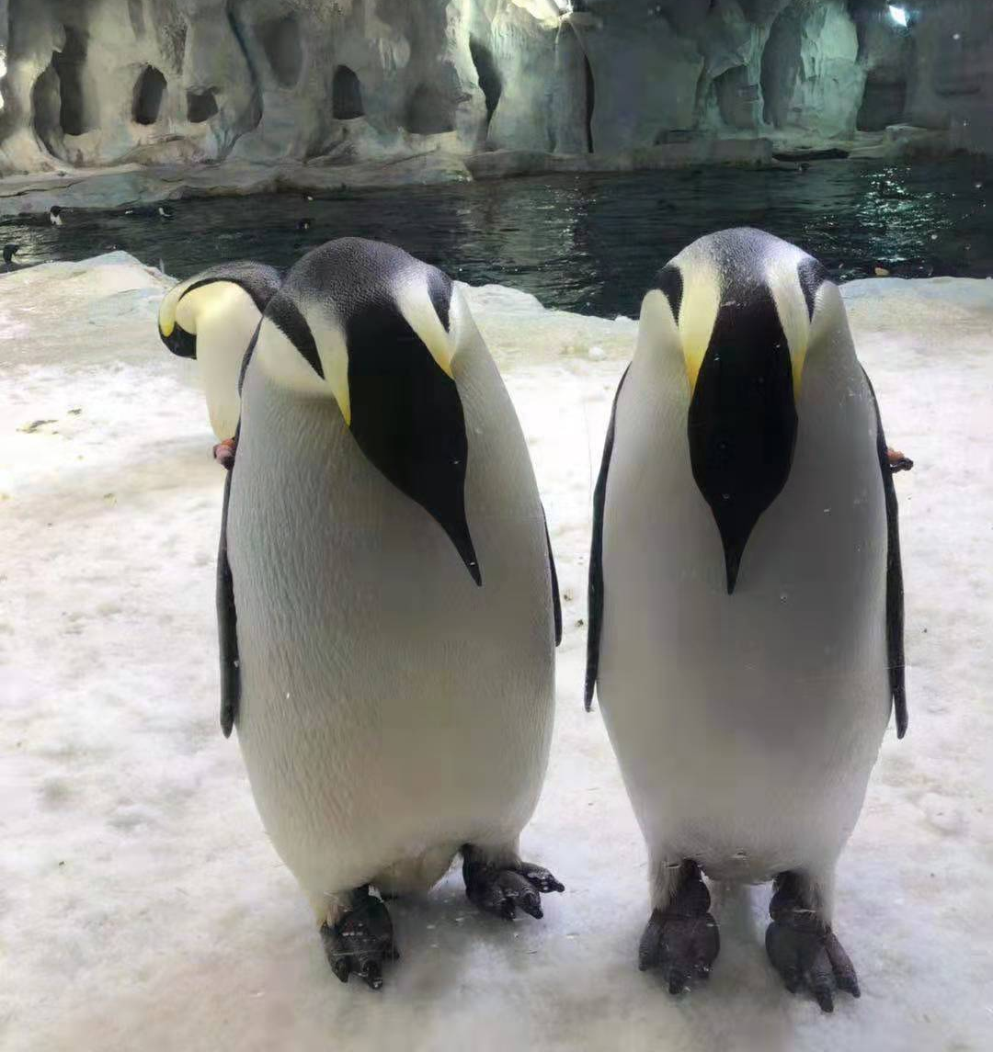
Changlong Ocean Kingdom
On July18th, my mom and I went to the Changlong Ocean Kingdom. We saw lots of animals there, my favorite animals are the emperor penguins.They are called the emperor penguins because they are the biggest penguins in the world.
The Emperor penguin’s feet and wings are black, but most of its fur is white. When the penguin swims in the water it's like an arrow.

Slide 3
Six Dynasties Museum
On August10th, my dad and I went to the Six Dynasties Museum.
It is a place filled with historical, artistic and cultural objects. But my favorite object there is the Celadon Lotus Respect.
The Celadon Lotus Respect is the largest and most exquisite of the same kind of artifacts in the Wei and Southern and Northern Dynasties. It is up to 85cm, the king of Celadon, and it is an rare piece of Buddhist art treasure.

Slide 4
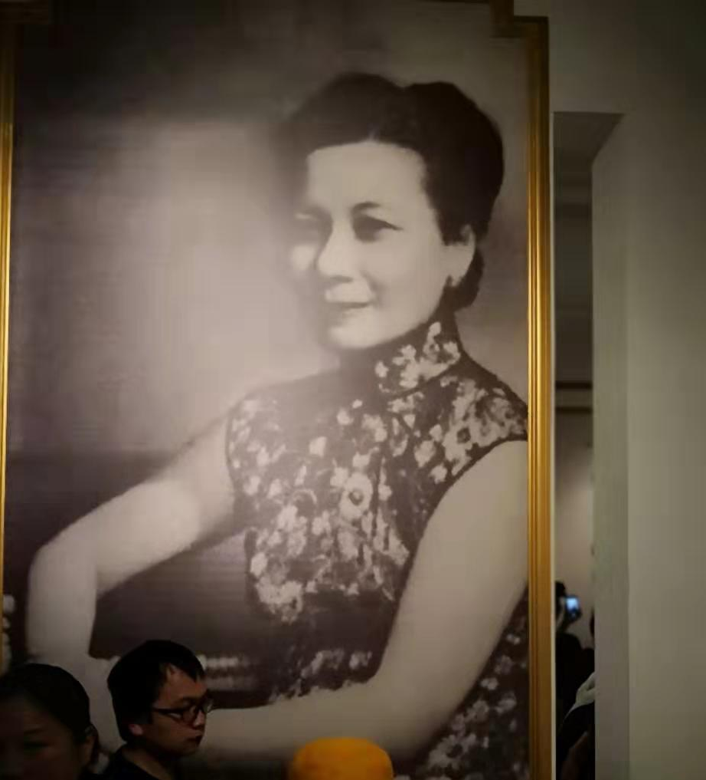
Meiling Palace
On August 11th, my dad and I went to the Meiling Palace, which is where Soong May-ling(宋美龄）usually live.
First we came into a big room, which was the bedroom of Chiang Kai Shek(蒋介石）and Soong May- ling, it was decorated with pictures of Soong May-ling and we could see a big balcony from where people could see the sunrise.
Then we walked in a room decorated with Soong May-ling’s meeting and a big self-portrait of Soong May-ling.

Slide 5
Tiger Hill Pagoda
On August13th, my dad and I went to the Tiger Hill.
At the center of the hill, there is a pagoda that tilts northeastward about 4 degrees, the world's second leaning tower. It is oblique because the foundation was built on soft ground that had difficulty supporting the weight.

Slide 6
Changzhou Dinosaur Theme Park
On August18th, my dad and I went to the Changzhou Dinosaur Theme Park. There are lots of dinosaur skeletons and dinosaurs made of plastic.
At night there was a big parade. My favorite ones were some people holding a light stick as a sword and wearing a pterosaur (翼龙）costume that glowed in the dark and a lady wearing a fairy costume that is standing on a amphicoelias fragillimus (易碎双腔龙）pulling a beautiful glowing翼 cart.

Slide 7
Thank you !

