Slide 1
Salt

Slide 2
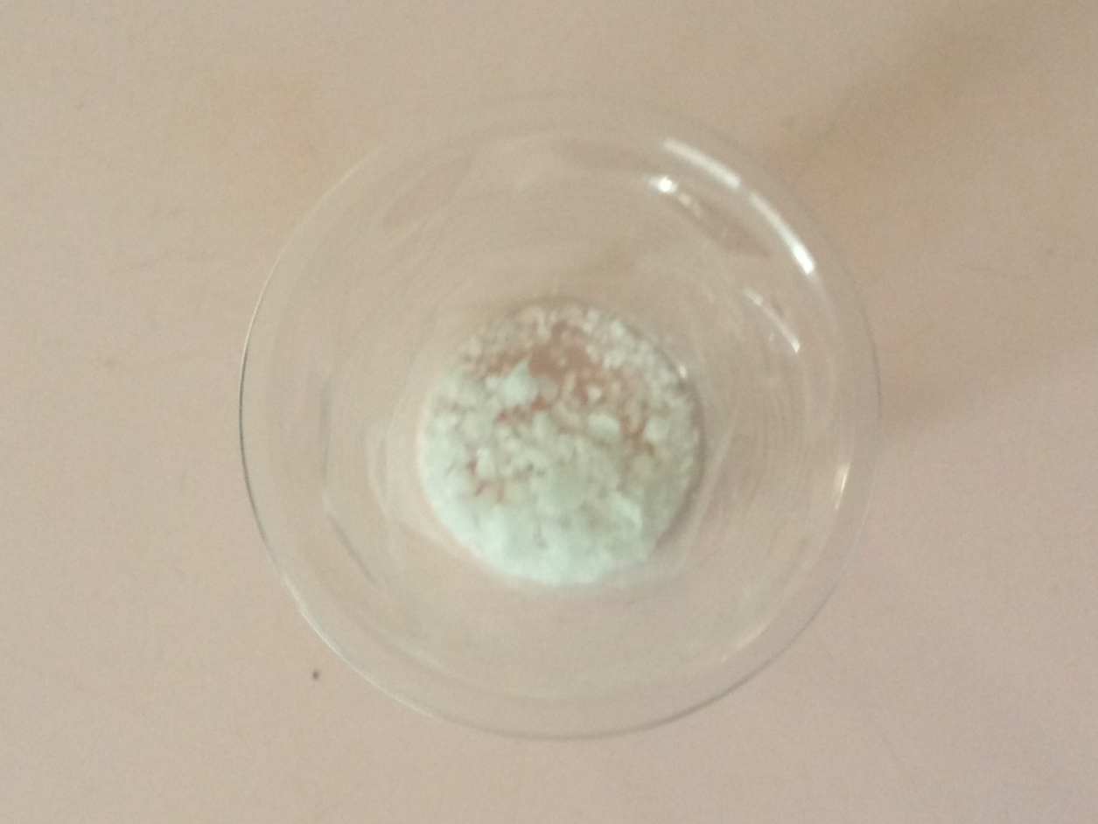
This summer，I put some salt in a cup of water .
After 3 weeks ，the water disappeared and the salt came out.

Slide 3
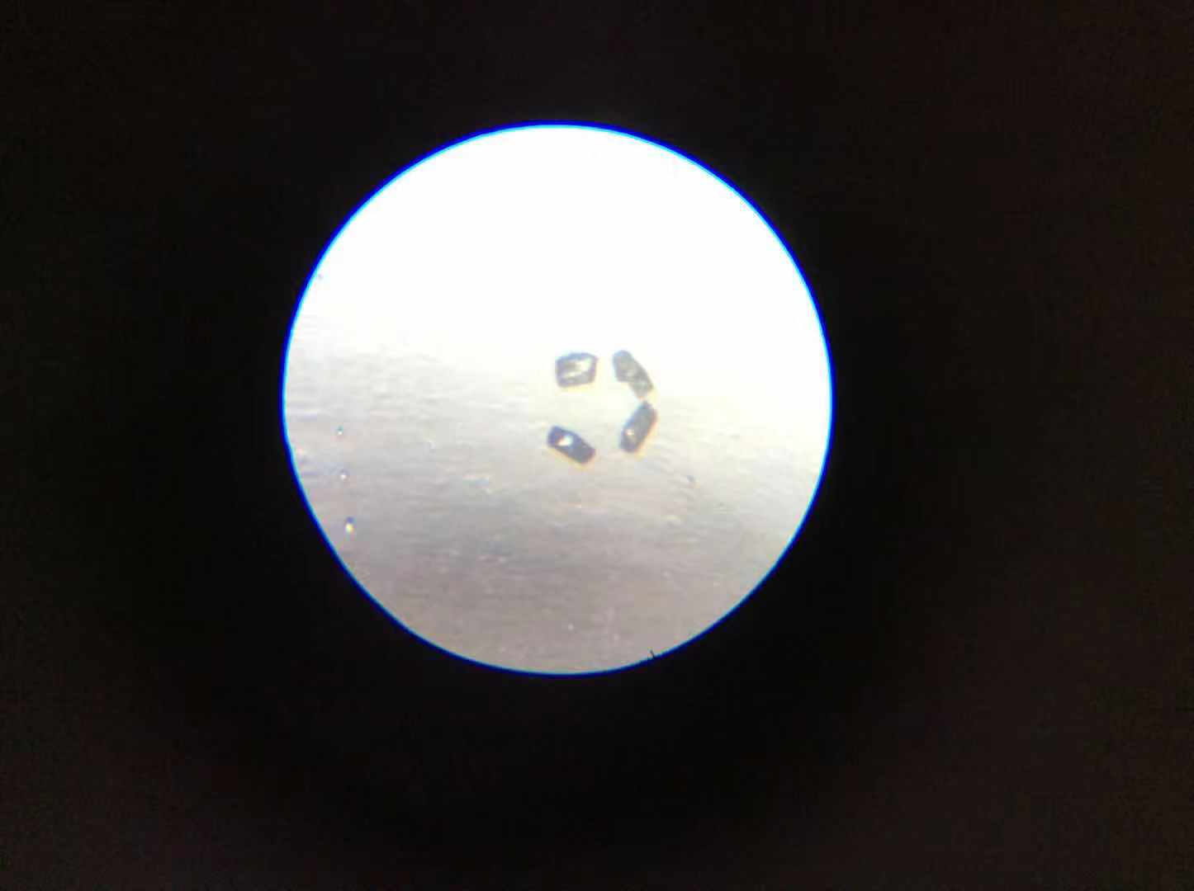
I bring out some salt and put them under my microscope. A miracle happened!

Slide 4
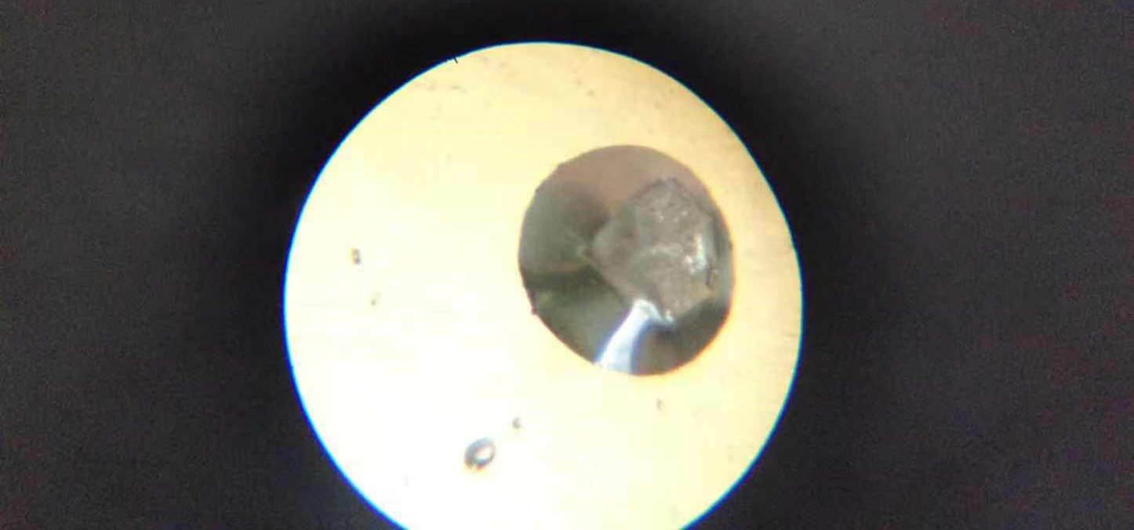
Some looks like a diamond.

Slide 5
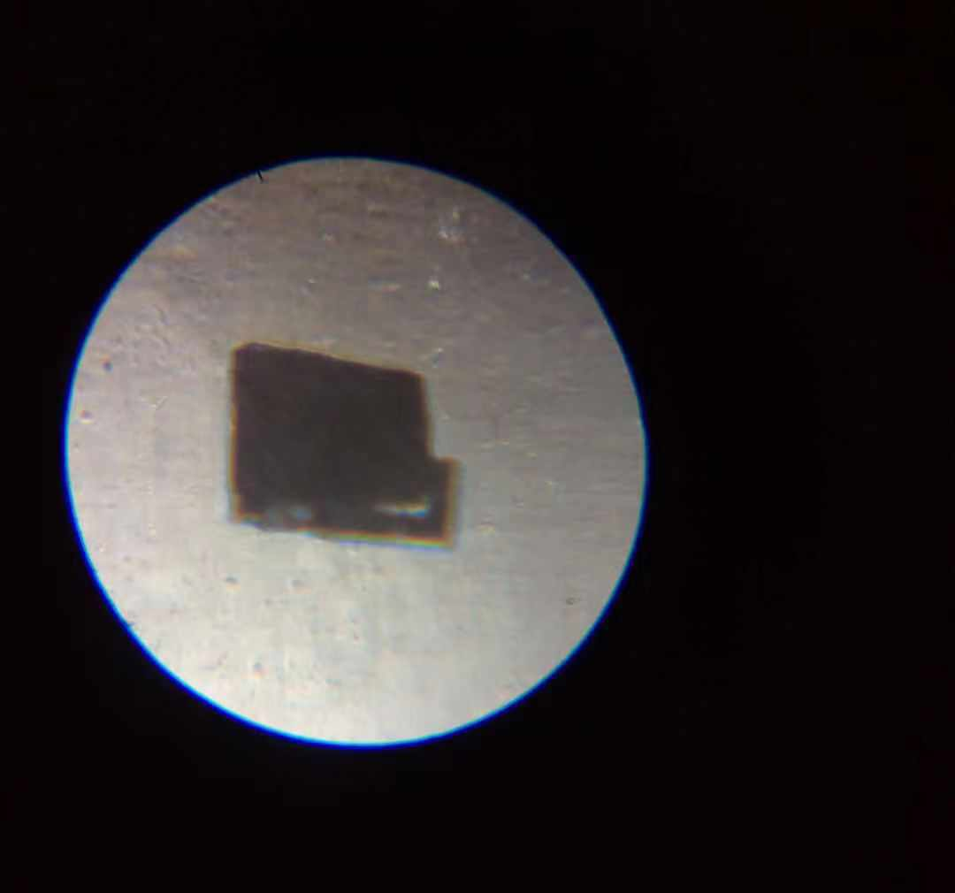
Some looks like a chocolate.

Slide 6
Do you like it?

