Slide 1
The summer holiday
fun
BY: Rachel

Slide 2
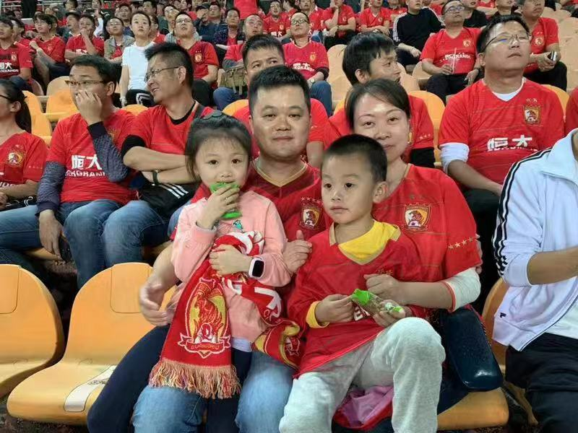
I am a fan of Guangzhou Evergrande
football team.
I often see them on TV.

Slide 3
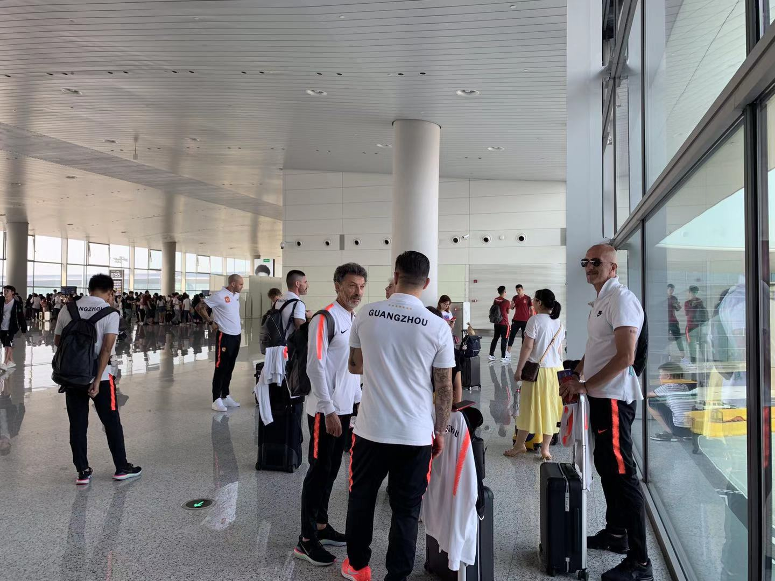
But in this holiday, I met them at the airport.
We even took the same flight. They sat behind me on the plane.

Slide 4
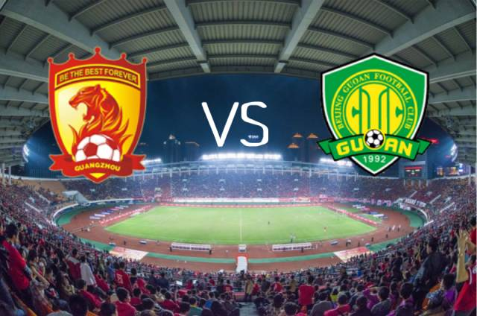
They were going to Beijing to play a game with Beijing guoan.

Slide 5
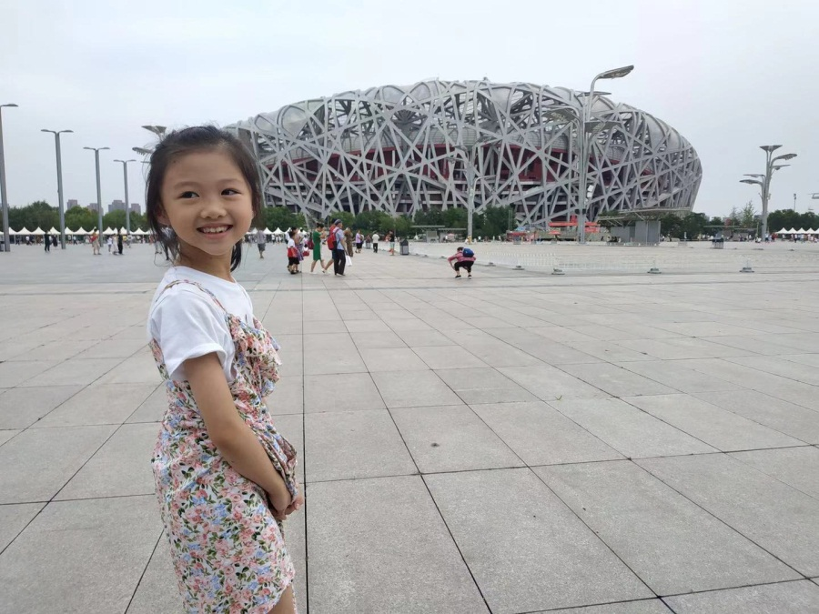
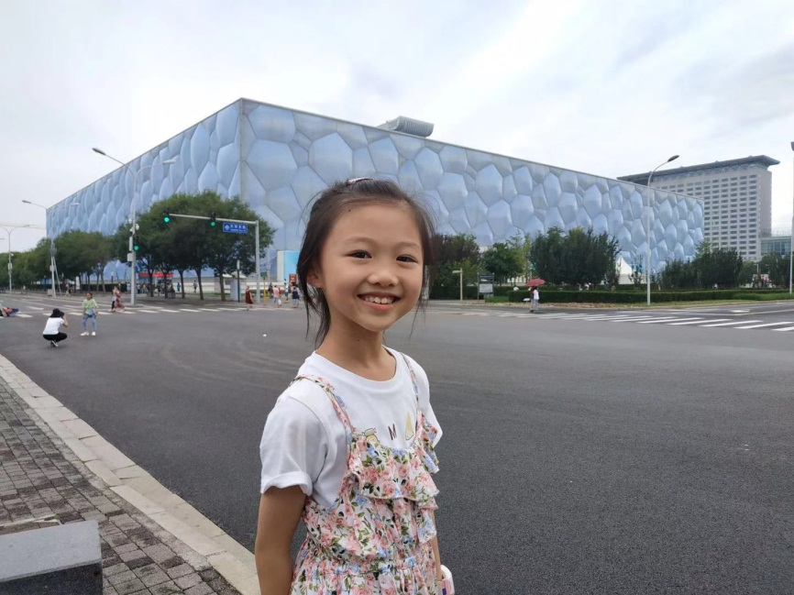
I was going on a trip to Beijing with my father.

Slide 6
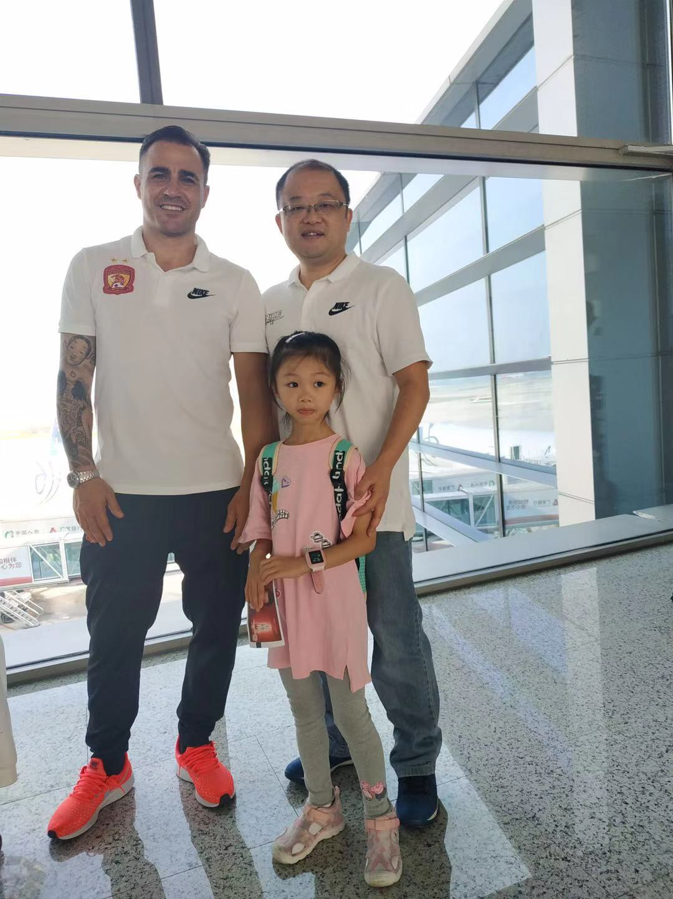
We toke a photo with Cannavaro.
He is the coach of the team.
Look!
My father wore the same shirt as him.

Slide 7
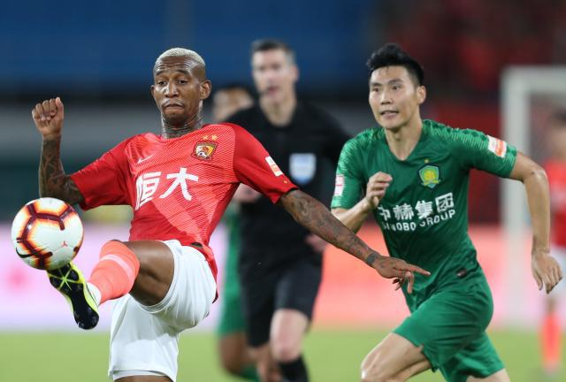
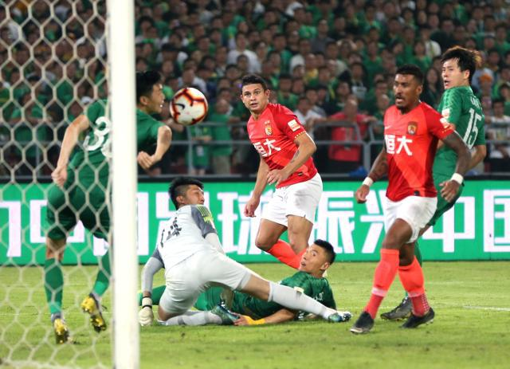
The next day, we watched the game on TV.
They won!
I was so happy!

